Slide 1

BIG DATA SENTIMENT ANALYSIS OF EMAILS
PROJECT ID : 109

Slide 2
Introduction
What
Text Analysis (text mining)
Natural Language Processing (NLP)
Why
Determines attitude of the speaker.
How
Classify polarity of the given text

Slide 3
Problem Statement
To analyse sentiments of emails stored in email server.

Slide 4
System architecture
Emails
Outlook server
Emails
Emails
Emails
Eliminating Spam and deleted
Extract
Display Analysis Result
Apache Cassandra
Dashboard
Analysis
result
Import to R
For analysis
R
Dictionary
Msg column for
Extracting
nouns
“match” words
Python

Slide 5
Algorithm
1.Create a dictionary
1.1: Insert business specific words
1.2: Assign polarities to the words
1.3: Assign polarity scores
2.Establish connection between R and Apache Cassandra
3.Use match function to match the words from the user dictionary and the email.
>> Using NLP tag the nouns in the emails for further GUI enhancement.
4.Omit all the words that return NA in the match function using test analysis.

Slide 6
5.Add the polarity scores of all the remaining words to get the overall polarity of the email.
6.if(total_polarity)>0then
write(Email with positive sentiments)
else
write(email with negative sentiments)
6.Store this analysis again in MongoDB using put function.
>>Create a word cloud displaying important words in emails
7.Use necessary tool to display this stored analysis result in highcharts dashboard to get a GUI based analysis.

Slide 7
Analysis
The system will generate output which will be either positive or negative. Since we have to scan huge amount of data, we obtain the output in non-deterministic polynomial time. Thus, the problem is NP-complete problem.
The time complexity for retrieving the emails will be O(1).

Slide 8
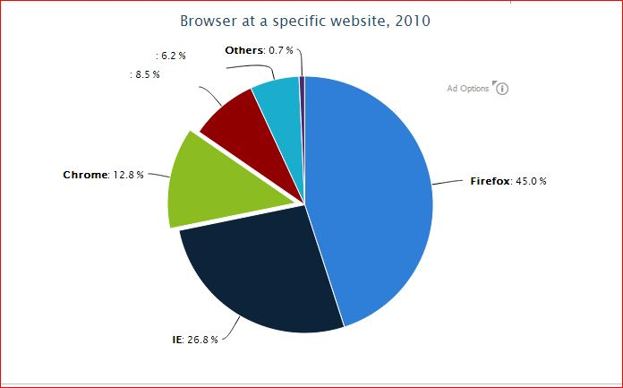
Results
Highcharts:
The final output is proposed to be displayed using Highcharts.

Slide 9
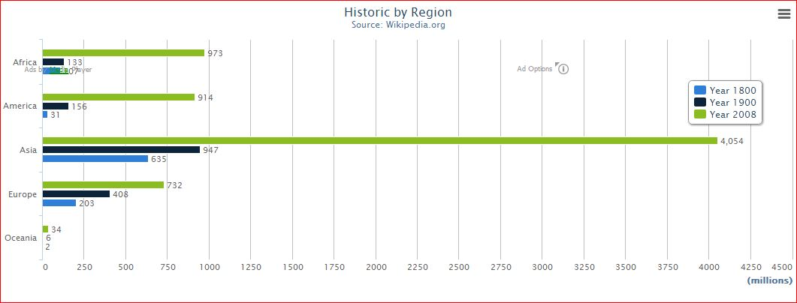

Slide 10
Innovation in project
Introduction of a special feature called “Word Cloud”.
GUI enhancement using “Highcharts”.
Using a combination of “R” for analysis and “Python” for NLP.

Slide 11
Conclusion
The system provides us with the analysis result stating whether the emails imply a positive or negative attitude.
It provides an additional feature of “word cloud” which returns the most discussed words among people.
Due to the use of Apache Cassandra we are able to analyse unstructured and huge data with ease.

Slide 12
THANK YOU !!

